Slide 1
What is signal?

Slide 2
What is signal?
Time-varying voltage, current or electromagnetic waves that carry information
Analog or digital representations of analog physical quantities
Analog signal: a continuous value in which a time varying quantity (i.e. voltage, pressure, etc…) represents another time-based variable – one variable is an “analog” of the other.
Dimmer switch connected to a light bulb. The dimmer has an infinite number of positions from off and full – and a corresponding infinite number of output from the light bulb
Digital signal: express the variation in discrete values.
More like an “on/off” switch.
Most analog signal is converted to a digital form so that it can be transmitted, stored, or processed.

Slide 3
Simple Transducer Circuit
Analog to Digital Converter
Signal
Tranducer
Amplifier
Readout
1 2 3 4 5 6
Current = i
k*i
v = f(i)
Number

Slide 4
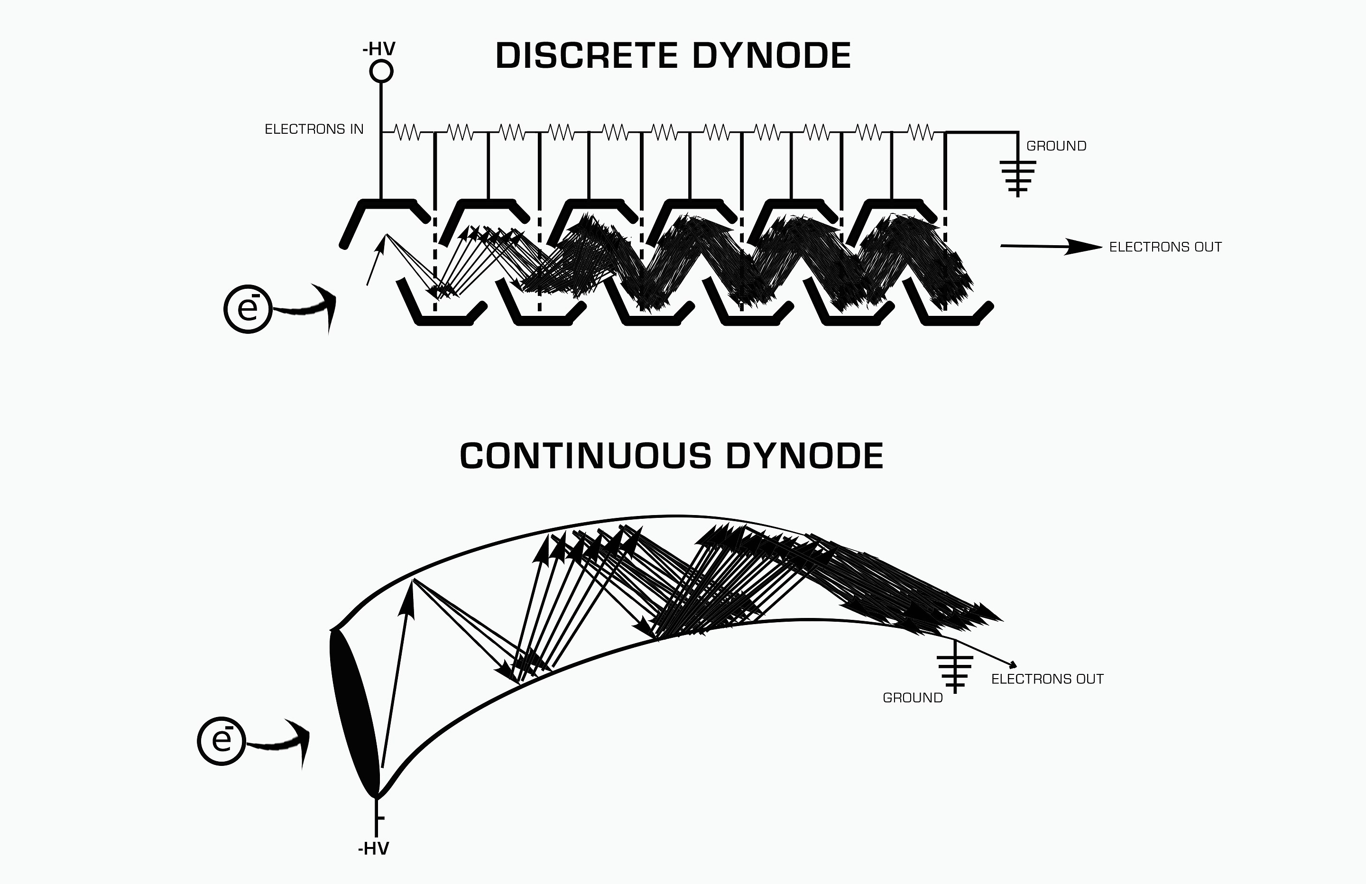
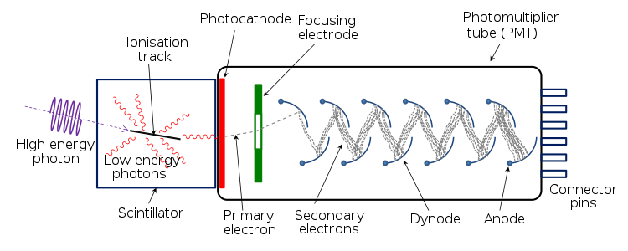
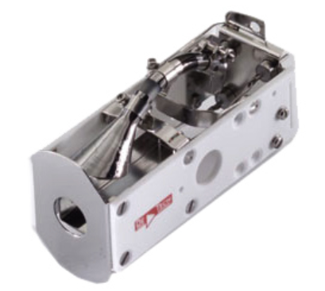
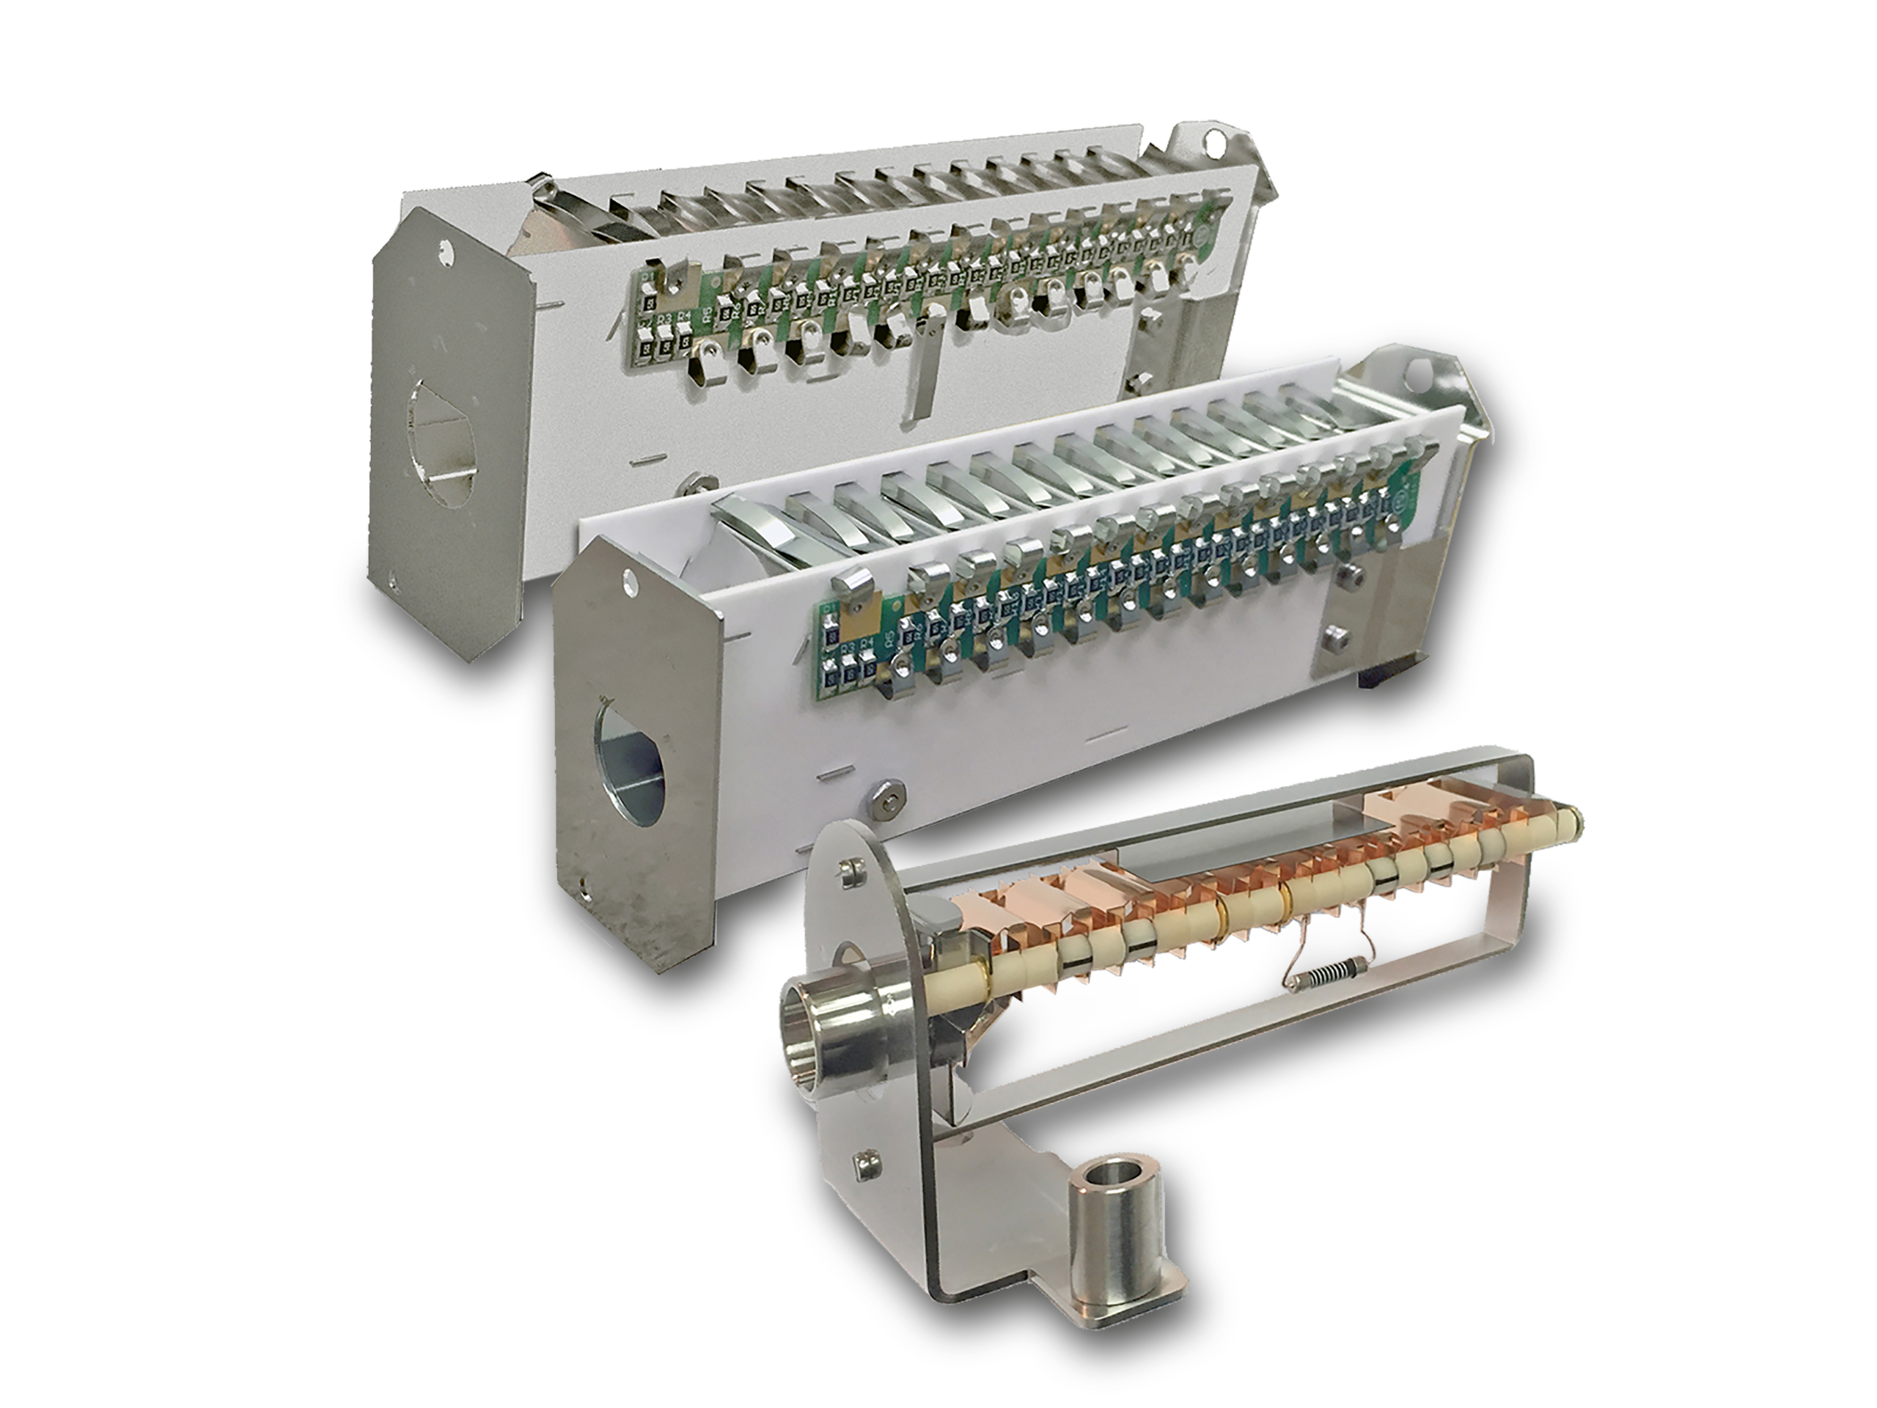
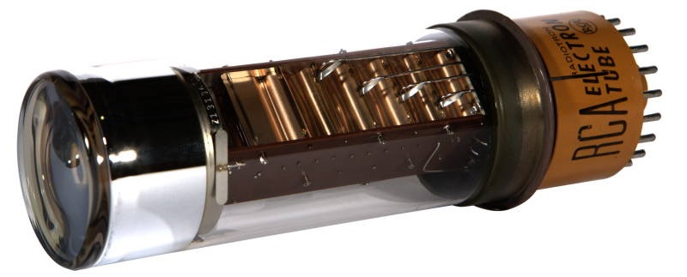
Transducers are similar for photons and ions
Photomultiplier Tube
Electron Multiplier

Slide 5
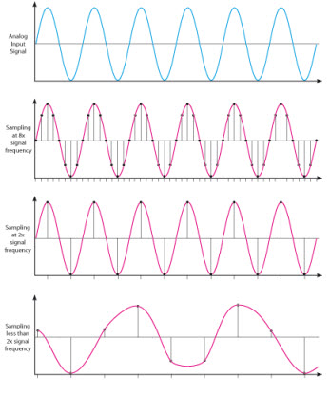
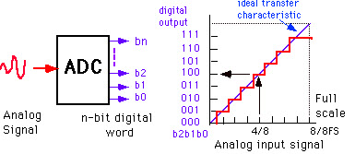
Important aspects of ADCs (digital conversion)
Sampling Rate
How fast the ADC can convert the signal?
Bit resolution
How much accuracy can the ADC convert from analog to digital?
3-bit ADC can provide 2³ divisions (8) in signal
8-bit ADC = 256 division
16-bit ADC = 65536

Slide 6
What is noise?

Slide 7
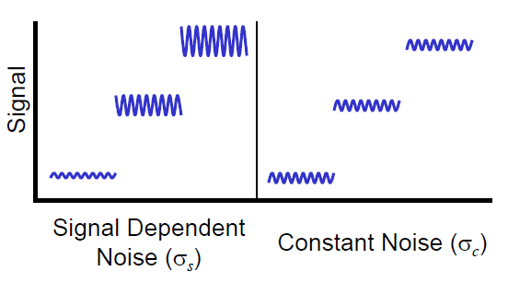
Types of Noise
heteroscedastic noise
homoscedastic noise

Slide 8
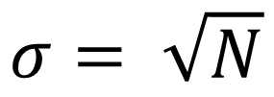
Types of Noise
Johnson noise (aka Thermal noise): noise from the thermal motion of electrons in the electronics. Constant and independent of the measured signal. Dependent on temperature and resistance in the electronics. Can be limiting factor at very high sensitivity measurements.
Shot noise (aka Poisson noise, counting noise): Random variations in electron or ion motion lead to random variations in current. The higher the current, the larger the shot noise.
$$σ= \sqrt{N}$$

Slide 9
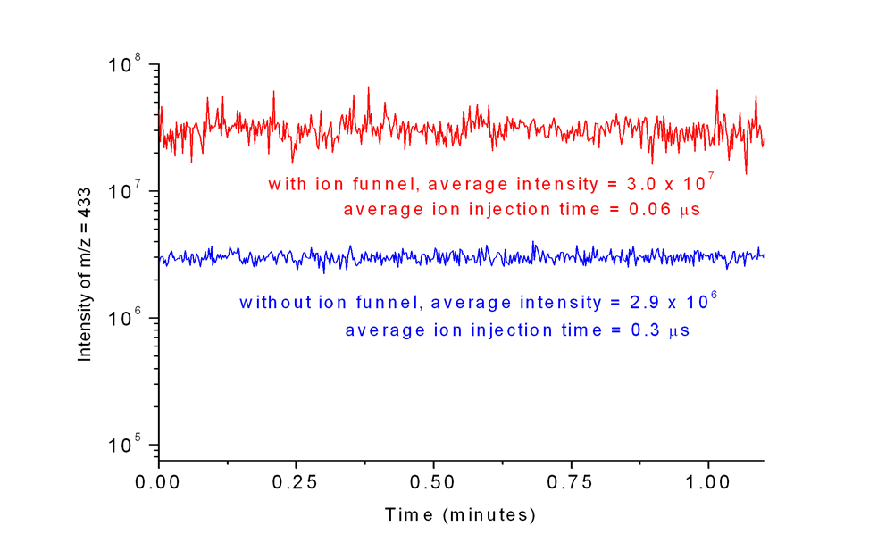
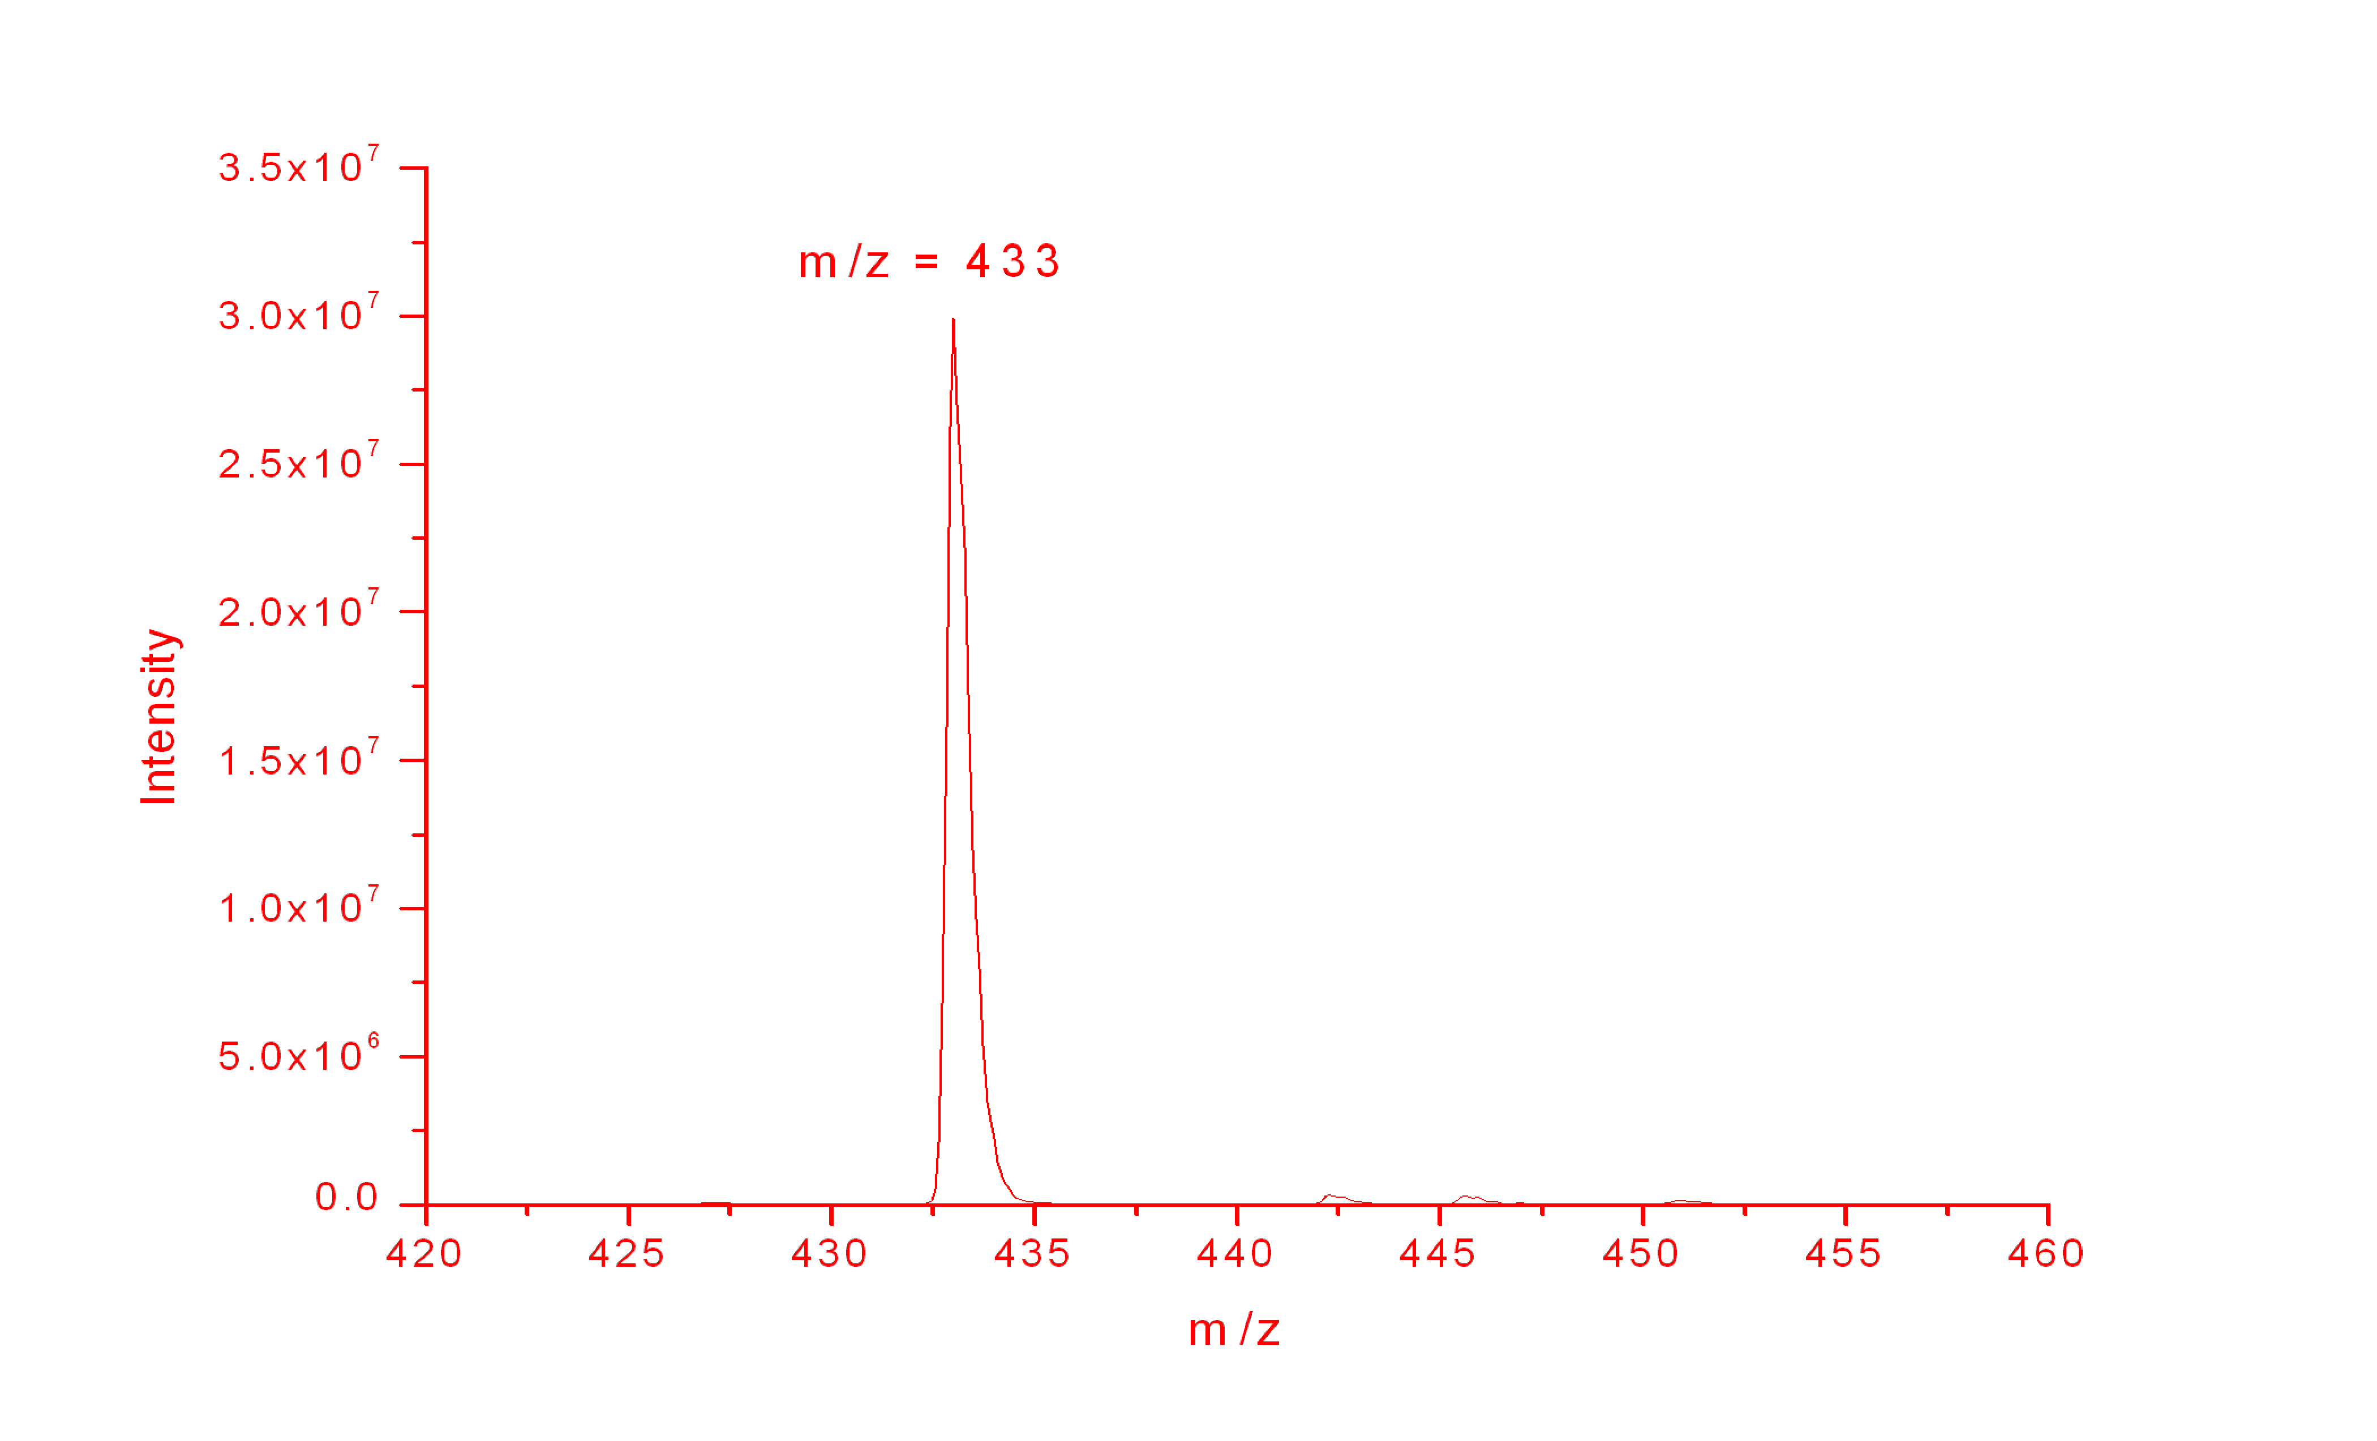
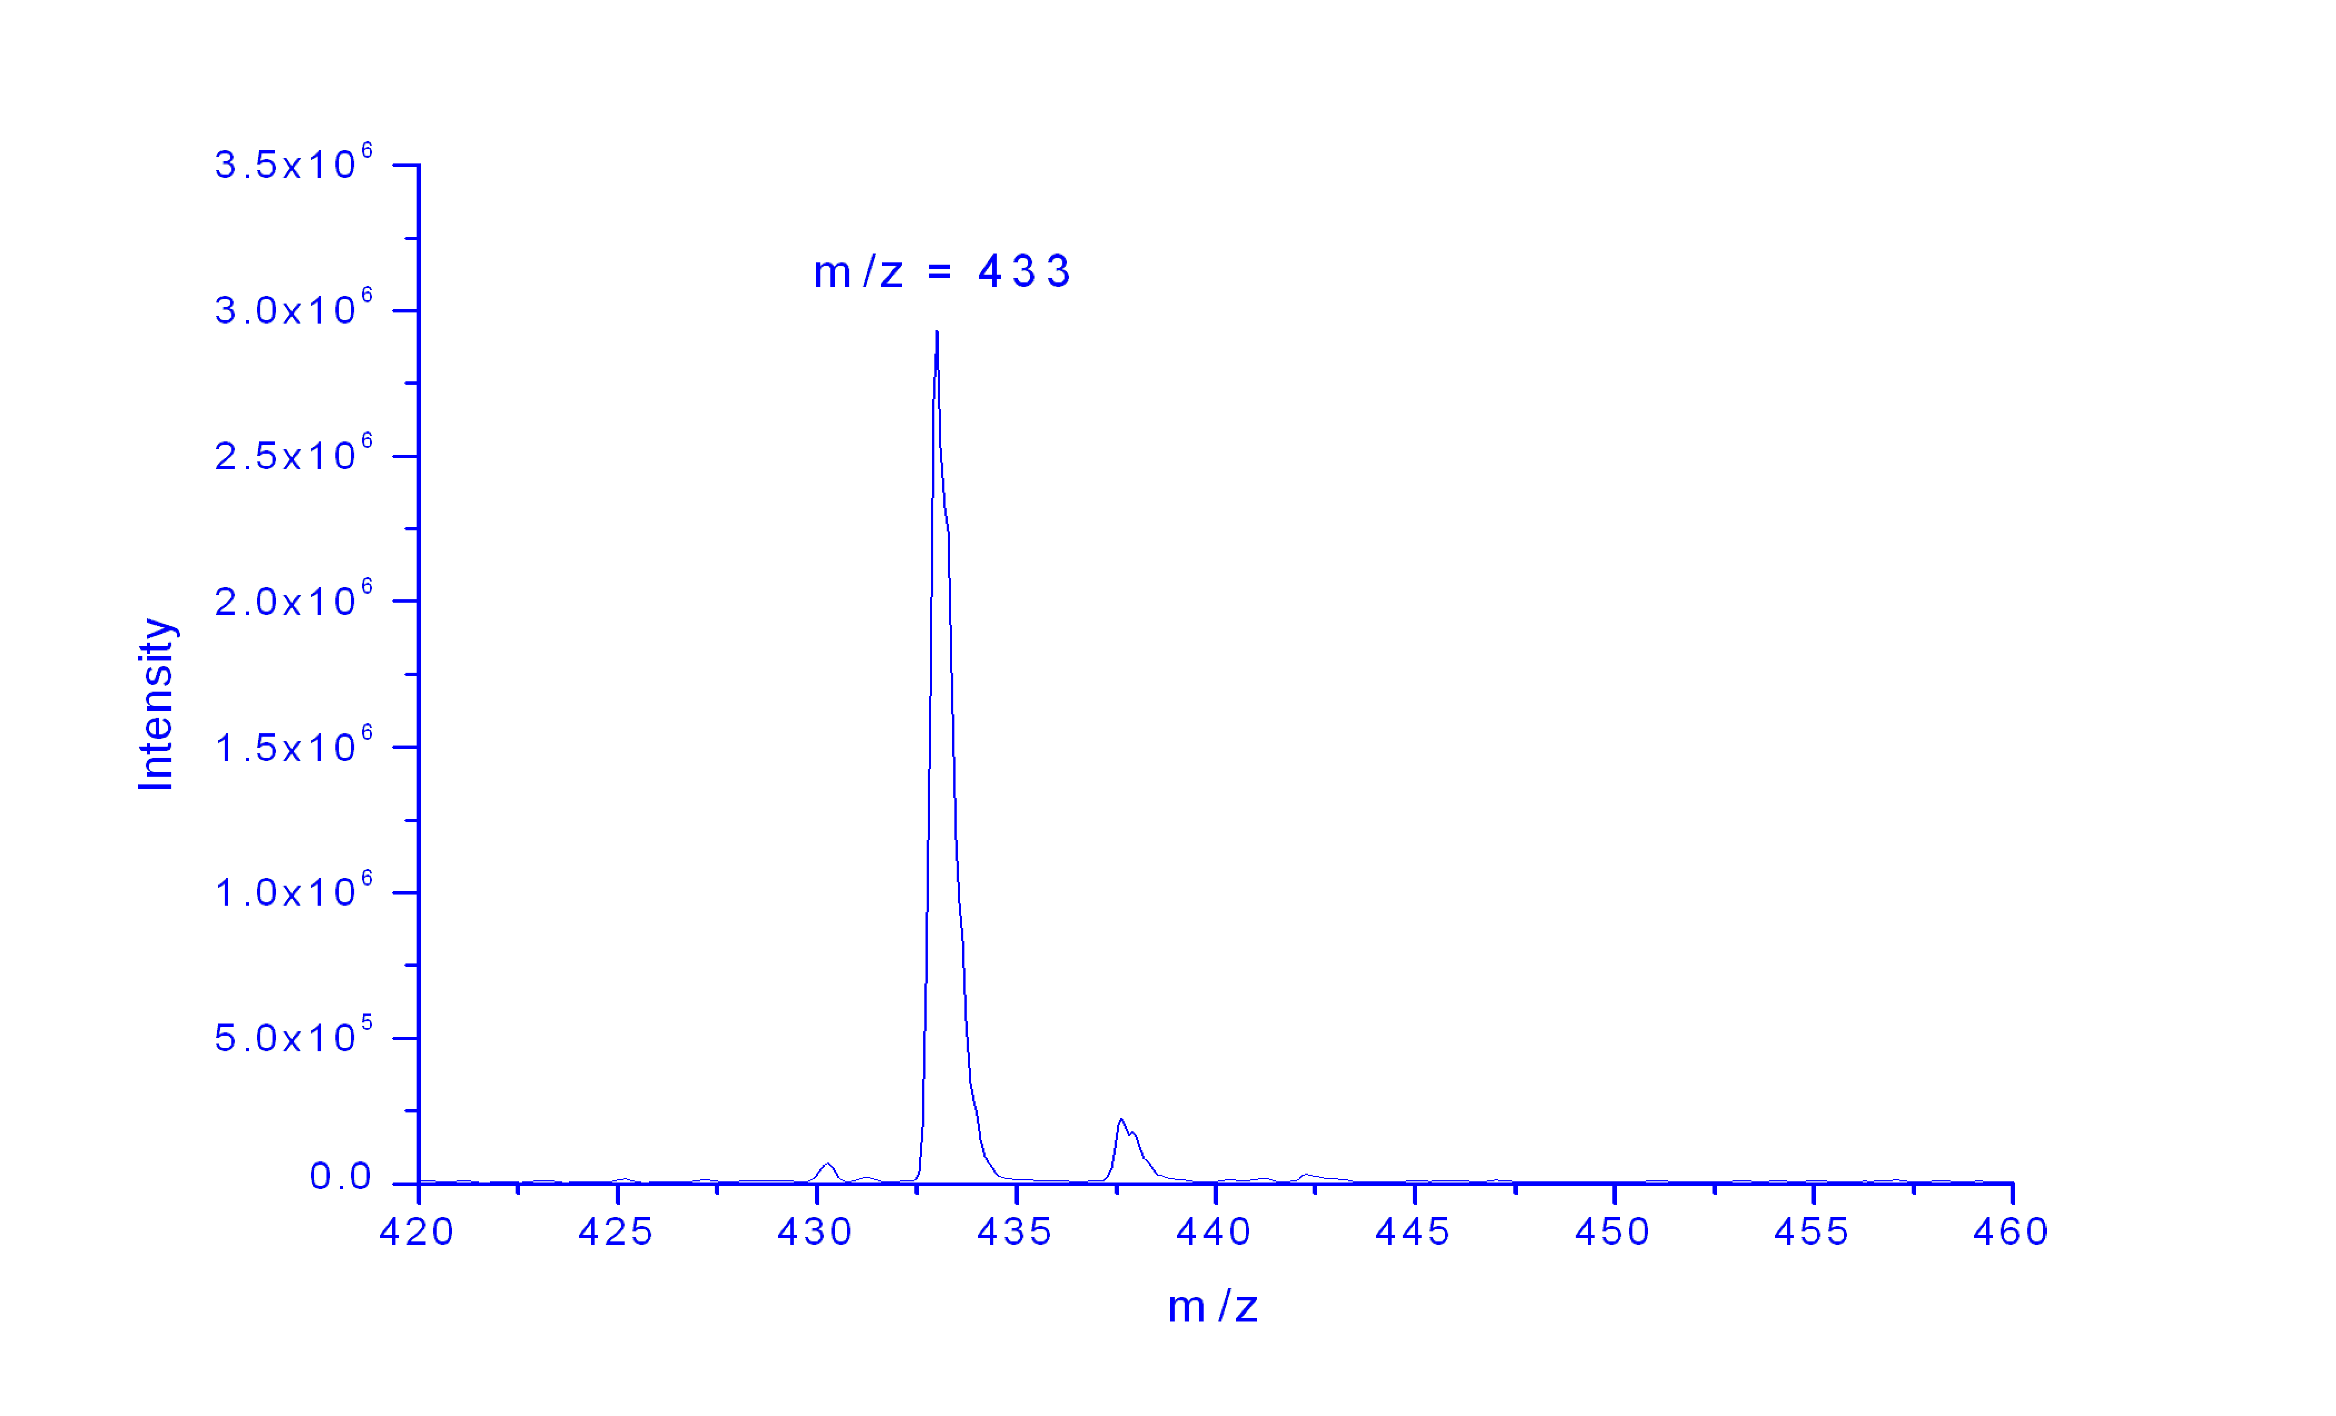
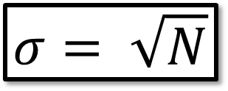
Shot Noise
~10x Improvement in Signal
~3x Improvement in S/N
$$σ= \sqrt{N}$$

Slide 10
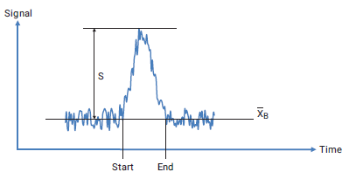
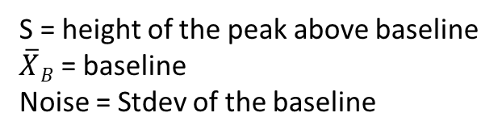
Ways to express Signal to Noise?
Most Common Way
What is wrong with this?
Signal to Baseline Noise
S = height of the peak above baseline
$\overline{X}B$ = baseline
Noise = Stdev of the baseline

Slide 11
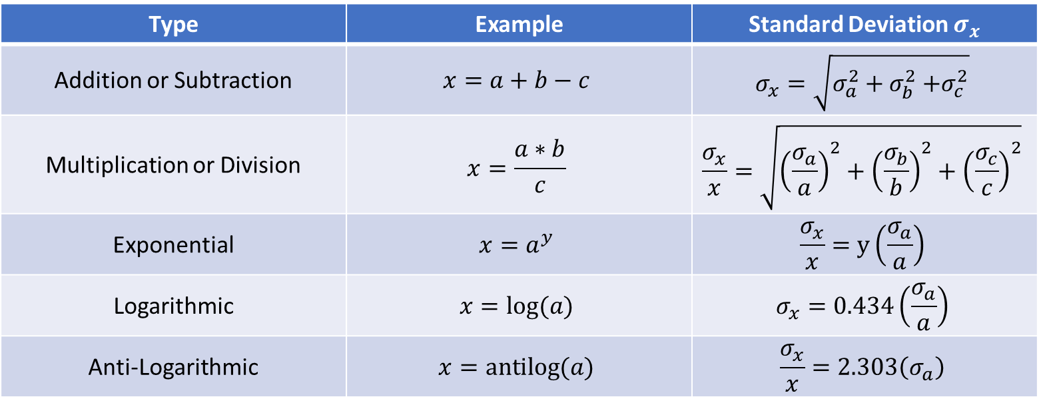
Propagation of Error
Type | Example | Standard Deviation $σ_{x}$
Addition or Subtraction | $$x=a+b−c$$ | $$σ_{x}=\sqrt{σ_{a}^{2}+σ_{b}^{2}{+σ}_{c}^{2}}$$
Multiplication or Division | $$x=\frac{a∗b}{c}$$ | $$\frac{σ_{x}}{x}=\sqrt{{\left(\frac{σ_{a}}{a}\right)}^{2}+{\left(\frac{σ_{b}}{b}\right)}^{2}+{\left(\frac{σ_{c}}{c}\right)}^{2}}$$
Exponential | $$x=a^{y}$$ | $$\frac{σ_{x}}{x}=y\left(\frac{σ_{a}}{a}\right)$$
Logarithmic | $$x=log⁡(a)$$ | $$σ_{x}=0.434\left(\frac{σ_{a}}{a}\right)$$
Anti-Logarithmic | $$x=antilog⁡(a)$$ | $$\frac{σ_{x}}{x}=2.303\left(σ_{a}\right)$$
Where a, b, c are measured variables from an experiment and $σ_{a}$, $σ_{b}$, and $σ_{c}$ are the standard deviations.

Slide 12
What sort of noise source is dominant?

Slide 13
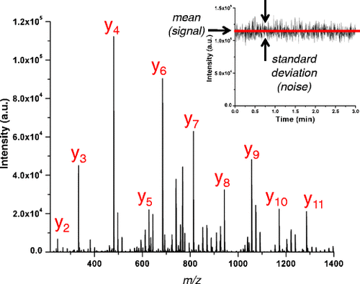

Slide 14
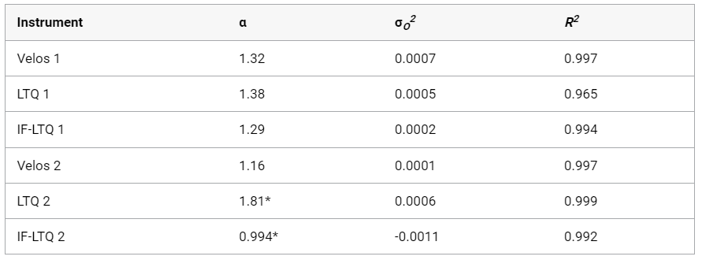

Slide 15
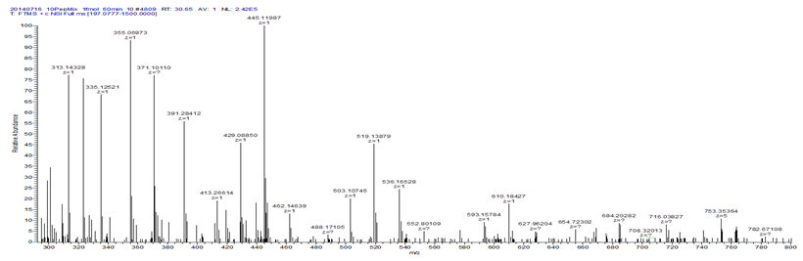
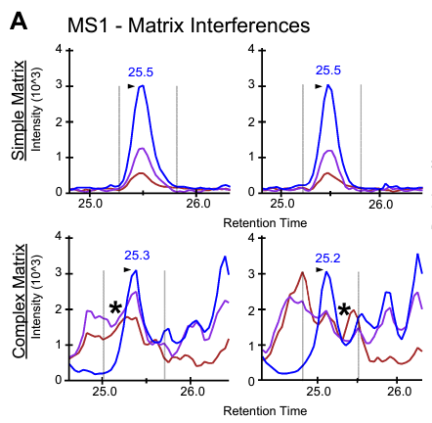
Other sources of noise?
Chemical noise (aka interference)
Interactions with other molecules in:
Sample
Room
Environmental noise
Frequencies that are picked up by RF detection electronics

Slide 16
Common Examples:
Dolby noise reduction: perform FFT, remove high frequency portion of the spectrum, inverse FFT
Noise cancelling headphones: A microphone records what is happening outside and the exact opposite frequency is applied to cancel those sounds out.

Slide 17
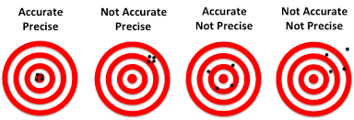
Precision vs Accuracy
Precision is about taking multiple attempts—such as shots, guesses, or measurements—and having all of them end up very close to each other.
Accuracy is about having your attempts land at the true or desired location.

